Slide 1
Transverse Wave Motion
18th September 2018

Slide 2
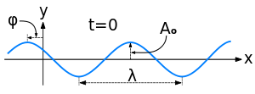
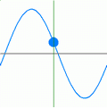
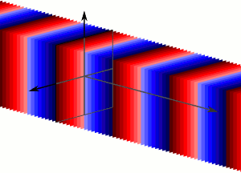
Concept of Plane wave
A typical representation of a wave propagating in space
The propagating wave causing the individual oscillators in the medium to oscillate
Overall oscillation of the oscillators with the same phase in the same plane forms the travelling plane wave.
Note : each color represents a different phase of the wave.
https://en.wikipedia.org/wiki/Plane_wave
Notes:
Plane wave : the name refers to the geometry of the wave surface.
Apart from the plane, cylindrical and spherical waves are two most common waves easily found.
The form of any wave (matter or electromagnetic) is determined by its source and described by the shape of its wavefront, i.e., the locus of points of constant phase. If a traveling wave is emitted by a planar source, then the points of constant phase form a plane surface parallel to the face of the source.

Slide 3
Velocities in wave motion
For a mechanical wave, the individual oscillators which make up the medium do not progress through the medium with the waves.
The three velocities in wave motion are
1. The particle velocity
2. The wave or phase velocity
3. The group velocity
For a monochromatic wave, the group velocity and the wave velocity are identical.

Slide 4
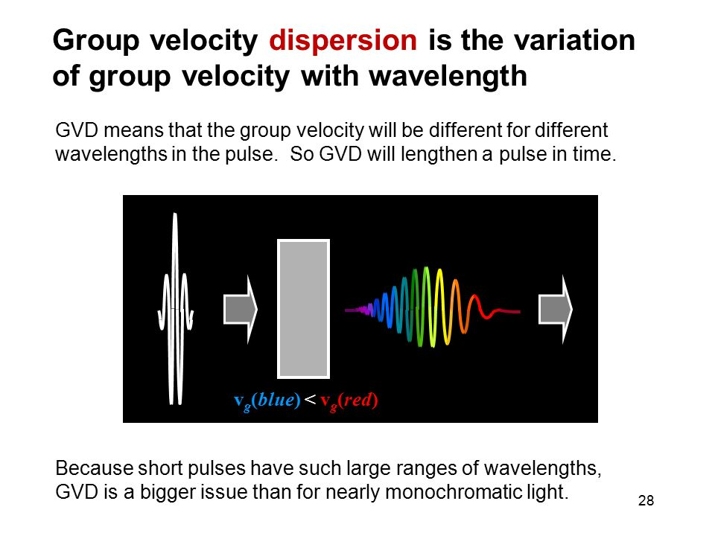
White light pulse consists of an infinite fine spectrum of frequencies and moving with a group velocity.
The wave velocity of each wavelength in the group is different.
The phenomenon is known as dispersion.
(GVD = Group Velocity Dispersion)
http://slideplayer.com/slide/10965793/

Slide 5
The transverse wave equation on a string
A very short section of a uniform string has a vertical displacement.
The wave equation relates the vertical displacement y to time t and position x.
Given that the linear density ρ and a constant tension T along a slightly extensible string, the wave equation is given as

Slide 6
Ideal string constraints
In order for the wave equation to apply to the waves in a string, it must meet certain constraints. For an ideal string, it is assumed that
1. The string is perfectly uniform with a constant mass per unit length, and is perfectly elastic with no resistance to bending.
2. The string tension is presumed to be large enough so that gravity can be neglected.
3. Small segments of the string are presumed to move transversely in a plane perpendicular to the string, and that the displacements and slopes of segments of the string are small.
http://hyperphysics.phy-astr.gsu.edu/hbase/Waves/waveq.html#c2

Slide 7
How to obtain the wave equation
By applying the Newton’s second law of motion, the horizontal force components on the element are cancelled.
And, the vertical force components results in
According to the definition of the partial derivative, we have
; c is the wave velocity.
Notes:
Dx = dxcosθ and because θ→0, ∴dx ≈ds

Slide 8
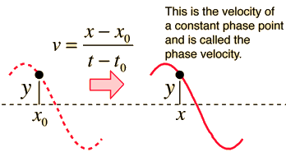
Solution of the wave equation : travelling wave
The solution of the wave equation is a function of the variables x and t.
The right and left travelling (or progressive) waves can be written as
Note :
Initially, a wave function is given as y = asin(ωt₀ – kx₀).
At a later time t (>t₀), the wave function becomes y = asin(ωt - kx).
∴ ωt₀ – kx₀ = ωt – kx and this leads to x > x₀ . This suggests the right moving waveform.
http://hyperphysics.phy-astr.gsu.edu/hbase/Waves/wavsol.html#c3

Slide 9
Characteristic impedance
Any medium through which waves propagate will present an impedance to those waves.
The impedance to progressive transverse waves is defined as the transverse impedance,
The velocity v here is the particle velocity NOT the wave velocity.
For a harmonic force, the ratio of force to velocity tells you how hard it is to move the object – this depends both on how much inertia the object has and on how strong the restoring force is.
The impedance, represented a medium characteristic, can be either real (for lossless case) or complex (for loss case).
Notes:
For a harmonic force, the ratio of force to velocity tells you how hard it is to move the object – this depends both on how much inertia the object has and on how strong the restoring force is

Slide 10
Characteristic impedance of a string
The string as a forced oscillator with a vertical force F₀exp(iωt) driving at one end.
The displacement of the progressive waves may be given as
At the end of the string, x = 0, the wave is rewritten as
The velocity is found to be
The string characteristic impedance
The constant tension T in the string is balanced by the force at the end of the string.
Notes:
Since the velocity c is determined by the inertia and the elasticity, the impedance is also governed by these properties.

Slide 11
Reflection and transmission of wave on a string at a boundary
Waves on a string impedance ρ₁c₁ reflected and transmitted at the boundary x = 0 where the string changes to impedance ρ₂c₂
ρ₂c₂
ρ₁c₁
Boundary conditions at x = 0 :
1. geometrical condition : displacement is the same immediately to the left and right at x = 0 for all time (a continuity of the string)
2. dynamical condition : a continuity of the transverse force T(∂y∂/x) at x = 0, and therefore a continuous slope.

Slide 12
Incident, reflected and transmitted waves
Notes:
Yi = A1exp(wt-k1x)
Yr = B1exp(wt + k1x)
Yt = A2exp(wt – k2x)

Slide 13
Determination of the reflection and transmission amplitude coefficients
According to the boundary conditions (at x =0 for all t)
Notes:
Bc1 : continuity of the displacement
Bc2 : continuity of the transverse force

Slide 14
Reflection and transmission coefficients
Note : these coefficients are independent of ω and hold for waves of all frequencies.
What does it mean if Z₂ = ∞?
What does it mean if Z₂ = 0?
Notes:
What does it mean if Z₂ = ∞? This is a fixed end to the string because no transmitted wave exists. This gives B1/A1 = -1, so that the incident waves is completely reflected with a phase change of pi (phase reversal).
What does it mean if Z₂ = 0? This is a free end of the string, then B1/A1 = 1 and A2/A1 = 2. This explains the flick at the end of a whip or free ended string when a wave reaches it. The amplitude obtained in this case is observed at the boundary , eg. A2 = 2A1. Amplitude observed at other positions is still A1.

Slide 15
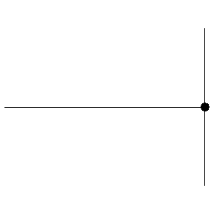
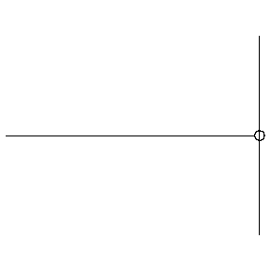
Reflections of string at fixed end (Z = ∞) and at free end (Z = 0)
At a fixed (hard) boundary, the displacement remains zero and the reflected wave changes its polarity (undergoes a 180º phase change)
At a free (soft) boundary, the restoring force is zero and the reflected wave has the same polarity (no phase change) as the incident wave
https://www.acs.psu.edu/drussell/demos/reflect/reflect.html

Slide 16
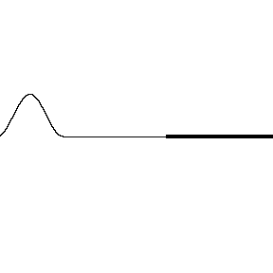
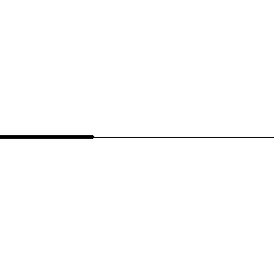
https://www.acs.psu.edu/drussell/Demos/reflect/reflect.html
An incident wave travelling from a low density (high wave speed) region towards a high density (low wave speed) region. | An incident wave travelling from a high density (low wave speed) region towards a low density (high wave speed) region.
How do the polarities of the reflected and transmitted waves compare to the polarity of the incident wave? | How do the polarities of the reflected and transmitted waves compare to the polarity of the incident wave?
Anything wrong with this animation!

Slide 17
Reflection and transmission of energy
Now, let’s consider what happens to the energy flow in a wave when it meets a boundary between two media of different impedance values.
Generally, the energy flow or the rate at which energy is being carried along a unit length, mass ρ, of the string as a simple harmonic oscillator of maximum amplitude A with travelling wave velocity of c is
This can be shown that the energy arriving at the boundary x = 0 is equal to the energy leaving the boundary. In other words, the energy is conserved.
Notes:
Normall

Slide 18
The conservation of energy
All energy arriving at the boundary in the incident wave leaves the boundary in the reflected and transmitted waves.
Note : The proof requires the transformation of B₁ and A₂ to be in terms of A₁.
Notes:
The transformation uses the reflection and transmission coefficients in the calculation.

Slide 19
The reflected and transmitted intensity coefficients
Note : if Z₁ = Z₂ no energy is reflected and the impedances are said to be matched.

Slide 20
The matching of impedances
Impedance matching represents a very important practical problem in the transfer of energy.
The concept of impedance matching is to have the impedance change slowly.
An appropriate length and impedance of another string between two mismatched strings will eliminate energy reflection and match the impedance.

Slide 21
The analysis of the matching impedances
To comply with the condition of matching impedances, the following ratio has to be unity,
To derive the impedance and the length of the inserted piece of the string, the boundary conditions are that y and T(∂y/∂x) are continuous across the junctions x = 0 and x = l.
This gives
Two impedances to be matched when and the thickness of the coupling medium is

Slide 22
Standing waves on a string of a fixed length
The displacement on the string at any point is given by
With the boundary condition that y = 0 at x = 0 and x = l at all times, thus
The complete expression for the displacement of the nth harmonic is given by
This may be expressed as
Where the amplitude of nth mode is given by

Slide 23
Energy of each normal modes of vibrating string
The energy in each harmonic is composed of kinetic and potential energy.
Where
Notes:
This has to be considered the unit length.

Slide 24
Standing Wave Ratio (SWR)
If a progressive wave system is partially reflected from a boundary, the incident and reflected amplitudes partially cancel out.
In this case the ratio of maximum to minimum amplitudes in the standing wave system is called
Where

Slide 25
Wave group
Superposition of two waves of almost equal frequencies
Superposition of amplitude and phase gives

Slide 26
Group velocity
Consider 2 cases which are the same phase velocities and different phase velocities.
(1) The two waves have the same phase velocities; i.e., ω₁/k₁ = ω₂/k₂ = c. This leads to
This suggests that the component frequencies and their superposition, or group will travel
with the same velocity, the profile of their combination remaining constant.
Notes:
The velocity of the envelope represents the group velocity.

Slide 27
Revisit the superposition of two waves of almost equal frequencies
The superposition produces an amplitude which varies between 2a and 0.
This situation is called complete or 100% modulation.
The high frequency wave is amplitude modulated.
This actually is an example of sent signal found in a communication technique for transmitting information.

Slide 28
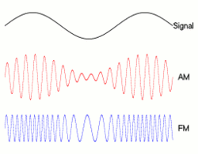
Amplitude Modulation (AM)
A general expression of an amplitude modulated wave is given as
Where the modulated amplitude
This gives
Two new frequencies (sidebands) are introduced.
https://en.wikipedia.org/wiki/Amplitude_modulation

Slide 29
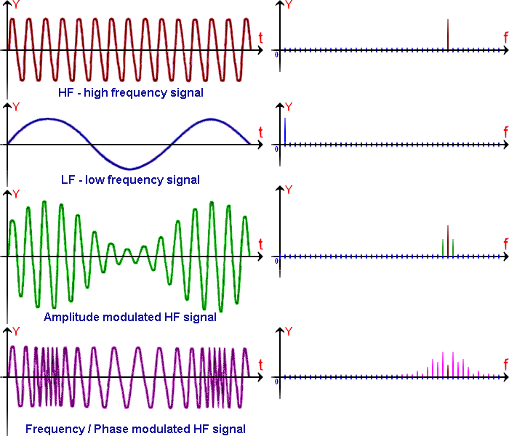
AM and FM in the time and frequency domains
https://informatics.buzdo.com/p030-signal-theory.htm

Slide 30
Group velocity (contd.)
(2) Two frequencies components have different phase velocities so that ω₁/k₁ ≠ ω₂/k₂.
The group velocity is given as
The superposition of the two waves will no longer remain constant and the group profile will change with time.
If a group contains a number of components of frequencies which are nearly equal the original expression for the group velocity is written

Slide 31
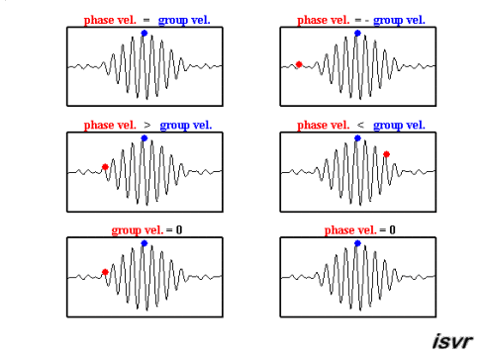
Phase velocity = Group Velocity
The component waves and their envelope moves as one.
Phase velocity = -Group Velocity
The envelope moves in the opposite direction of the component waves.
Phase velocity > Group Velocity
The component waves move more quickly than the envelope.
Phase velocity < Group Velocity
The component waves move more slowly than the envelope.
Group Velocity = 0
The envelope is stationary while the component waves move through it.
Phase velocity = 0
Only the envelope moves over stationary component waves.
Group velocity and phase velocity
http://resource.isvr.soton.ac.uk/spcg/tutorial/tutorial/Tutorial_files/Web-further-dispersive.htm

Slide 32
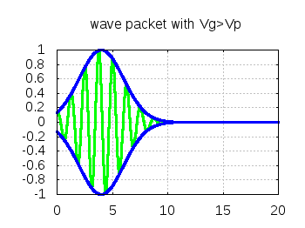

Dispersion relation
A medium in which the phase velocity is frequency dependent (ω/k not constant) is known as a dispersive medium and a dispersion relation expresses the variation of ω as a function of k.
This leads to three possible changes with time of the group velocity profile relative to the phase velocity.
They include
(1) v_{g} = v : a non-dispersive relation
(2) v_{g} < v : a normal dispersion relation
(3) v_{g} > v : an anomalous dispersion relation
http://theory.ipp.ac.cn/~yj/free_software.html

Slide 33
Illustration of dispersion relation
Since ω = kv,
This term can be either positive or negative.
Notes:
For normal dispersion ความยาวคลื่นยิ่งยาว ความเร็วยิ่งมาก คลื่นความยาวคลื่นยาววิ่ง “เร็ว” กว่าคลื่นความยาวคลื่นสั้น
For anomalous dispersion ความยาวคลื่นยิ่งยาว ความเร็วยิ่งน้อย คลื่นความยาวคลื่นยาววิ่ง “ ช้า “กว่าคลื่นความยาวคลื่นสั้น

Slide 34
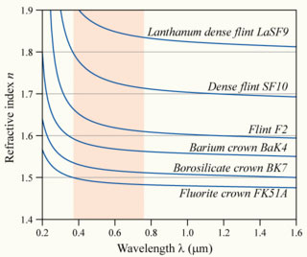
The dependence of refractive index to wavelength for various glasses
Are these various types of glasses non dispersive, normal dispersive or anomalous dispersive?
These are dispersive media because the phase velocity of each wavelength is not equal. This can be seen from the wavelength dependent refractive index.
Also, longer wavelengths move faster than shorter wavelength. This dispersive medium is categorized as the normal dispersive medium.
http://microscopy.berkeley.edu/courses/tlm/optics/chromatic.html
Notes:
They are normal dispersive because longer wavelengths have higher speeds than the shorter wavelengths.
In other words, dv/dλ > 0 and this corresponds to the condition of normal dispersive medium.

Slide 35
Transverse waves in a periodic structures representing a 1D crystal structure with identical single atom separated by a crystal lattice a
Consider the propagation of transverse waves along a linear array of atoms, mass m, in a crystal lattice where the tension T represents the elastic force between the atoms and a is the separation between atoms (so that T/a is the stiffness).
The displacement of rth particle due to the transverse waves is given as
By substituting the displacement into the equation of motion :
The permitted frequencies are found to be
This actually is the dispersion relation for waves travelling along a linear one dimensional array of atoms in a periodic structure.
Notes:
X=ra = ตำแหน่งของ displacement สำหรับ อนุภาคตัวที่ r
Permitted frequencies คือ ชุดค่าความถี่ของคลื่นที่เคลื่อนที่ผ่าน linear periodic structure นี้ได

Slide 36
What is the permitted frequency?
The expression for ω² is equivalent to jth normal mode frequency of a transverse wave on loaded string,
If (Show this?)
Therefore, the permitted frequency is actually the normal mode frequency of the transverse wave existing in the linear array of atoms in a periodic structure.
Permitted frequency
Notes:
โดยสรุปคือ permitted frequency คือ normal mode frequency

Slide 37
The maximum permitted frequency is found to be
This gives ka = π → λ =2a which is the allowed minimum wavelength for the transverse wave to propagate along the linear array of atoms in a periodic structure.
The graph below shows the dispersion relation (ω vs k) for the linear array atoms.
Due to , the permitted frequency is then represented as
Note that the repetition values of ω beyond the region -π/a≤ k ≤π/a, this region defines a Brillouin zone.
Notes:
Note that at the boundary of BZ k = pi/a, vg = dw/dk = 0

Slide 38
Dispersion relation for travelling long and short wavelength waves in a periodic structure
For long wavelengths or low values of the wave number k, sin ka/2 → ka/2
For short wavelengths, the phase velocity is given by
Note : only at very short wavelengths does the atomic spacing of the crystal structure affect the wave propagation.
Notes:
สำหรับคลื่นที่มีความยาวคลื่นสั้น ๆ เท่านั้น การ propagate ของมันจึงได้รับผลจาก atomic spacing

Slide 39
Dispersion relation for travelling waves in a periodic structure
Recall the dispersion relation:
The maximum permitted frequency is obtained when
Example : the elastic force constant T/a for a crystal is about 15 Nm⁻¹ and a typical reduced atomic mass is about 60 x 10⁻²⁷ kg. The maximum frequency is found to be about 5 x 10¹² Hz.
The maximum frequency is known as CUT OFF frequency.
Notes:
The frequency is in the infrared range of em spectrum.

Slide 40
Linear array of two kinds of atoms in an ionic crystal
In this case, a one dimensional line which contains two kinds of atoms with separation a is considered.
Given that atoms of mass M occupying the odd numbered positions and those of mass m occupying the even numbered positioned, the equation of motion for each type are
With solutions
The gives the dispersion relation

Slide 41
Derivation of the dispersion relation
From the previous slide, the equations of motion become
By arranging the above equations in the following matrix form, the dispersion relation can be worked out.

Slide 42
Dispersion relation for the ionic crystal structure
Provided that m > M.
Notice that the dispersion relation gives two possible situations.
With the positive sign, the change of ω as a function of k is considered.
The range of the wave number covers from k = 0 to k_{max} = π/2a (minimum λ = 4a)
For k = 0
For k_{max}
Notes:
The minimum λ can be found from dω/dk = 0

Slide 43
Dispersion relation for the ionic crystal structure
Provided that m > M.
Notice that the dispersion relation gives two possible situations.
With the negative sign, the change of ω as a function of k is considered.
The range of the wave number covers from k = 0 to k_{max} = π/2a (minimum λ = 4a)
For k = 0 ; For small k
For k_{max}
Notes:
The minimum λ can be found from dω/dk = 0

Slide 44
Dispersion relation for two modes of transverse oscillation in a crystal structure
According to the dispersion relation, two possible solutions can be found for m > M.
They are optical mode (upper branch) and acoustic mode (lower branch).
Also there is a forbidden band of frequencies between the two branches that the wave cannot propagate.
The gap depends on the differences of masses.

Slide 45
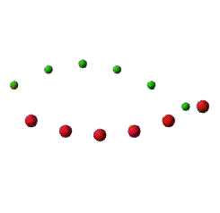

The motions of the two types of atom for each branch at k = 0 (infinite wavelength)
Optical mode for long wavelength and small k, A_{m}/A_{M} = -M/m
Acoustic mode for long wavelength and small k, A_{m} =A_{M}
http://slideplayer.com/slide/9413111/
Notes:
For the acoustic branch, the two atoms in the cell have the same amplitude and the phase. Therefore, the molecule oscillates as a rigid body.
For the optical branch, the optical oscillation takes place in such a way that the center of mass of a molecule remains fixed. The frequency of these vibrations lies in infrared region which is the reason for referring to this branch as optical.

Slide 46
Derivation of the motions of the two types of atom for each branch
Recall the equation of motion for the ionic crystal structure previously discussed,
The relative motion between m and M with a small k can be found when suitable frequency for each branch is considered.

Slide 47
Optical branch
Using one of the two equations from the matrix
For k = 0 →
The relative motion is found to be
Acoustic branch
Using one of the two equations from the matrix
For k = 0 →
The relative motion is found to be

